Slide 1

SHRI VISHNU ENGINEERING COLLEGE FOR WOMEN(A) (Approved by AICTE, Accredited by NBA & NAAC, Affiliated to JNTU Kakinada) BHIMAVARAM - 534202
DEPARTMENT OF COMPUTER SCIENCE AND ENGINEERING
CRAFTS E-COMMERCE WEBSITE
Project Team Members
Internal Guide
Mr. K. Raviteja – M . Tech (PhD)
Assistant Professor
M . Sita Varshini – 18B01A05A3 K. Vasudha Lakshmi – 18B01A0593 M. Haritha - 18B01A05A2 S. Divya Sri – 18B01A05B8 K.V. Mani Madhuri - 19B05A0511

Slide 2
Problem Statement
This Project aims to make all the different artifacts available at one place in our website.
Our website is user friendly as it help the customers to find the artifacts that the customers are looking for.

Slide 3
Proposed System
This project has the aim to make the artifacts available to all the people.
In order to implement it, Along with features of the existing system mentioned above we are trying to implement a new feature which is on-demand product delivery by using message option from customer side.
The customer can request directly to the seller via a message, regarding the product he wants If the product is not available currently .

Slide 4
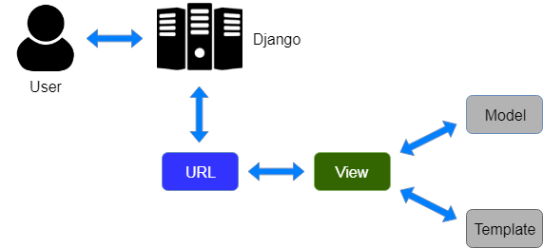
Project Wok Model

Slide 5
SYSTEM REQUIREMENTS
Software Requirements
Editor : Sublime text3 (or) Visual studio
Language : Python
FrameWork : DJango
Hardware Requirements
Processor: I9
RAM : 4GB
Space on Hard Disk : 1TB

Slide 6
UML dIagrams
Use case Diagram
Sequence Diagram
Class Diagram
Activity Diagram

Slide 7
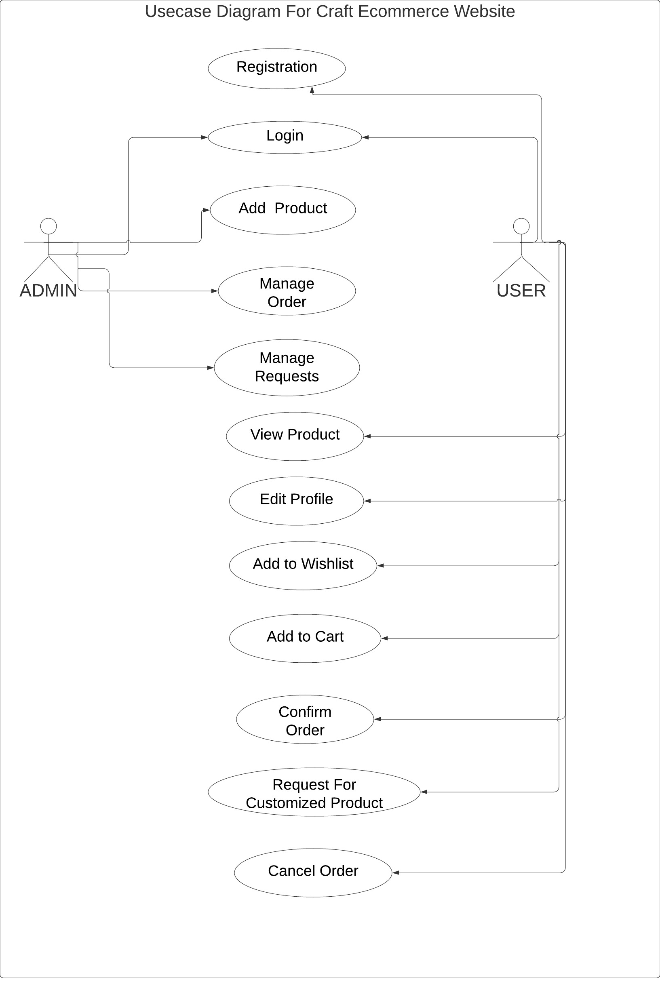
UseCase Diagram

Slide 8
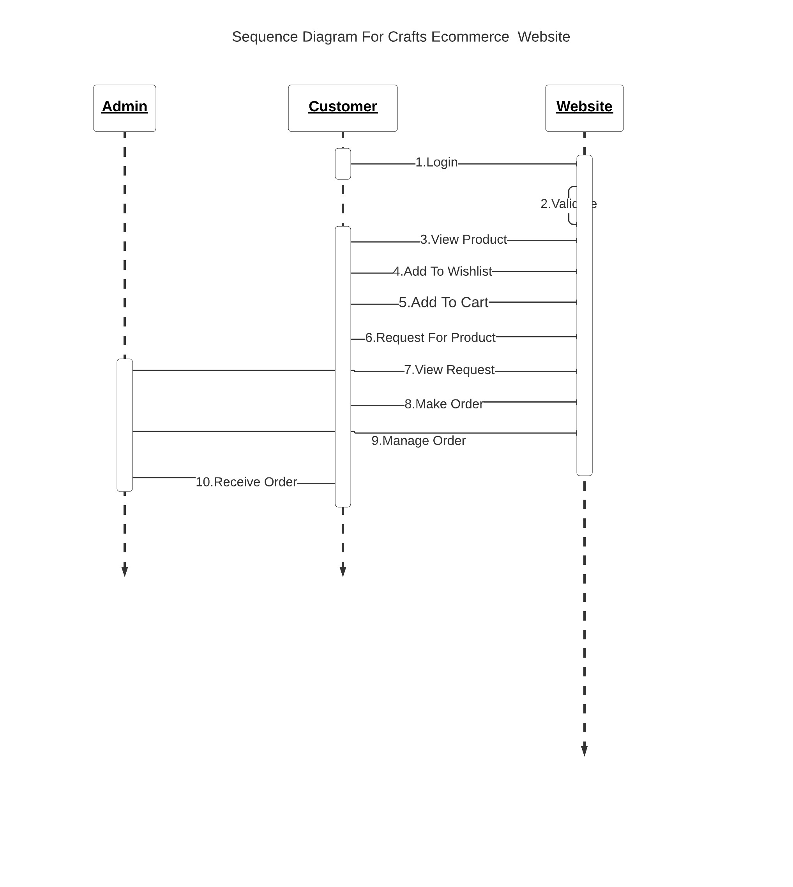
Sequence Diagram

Slide 9
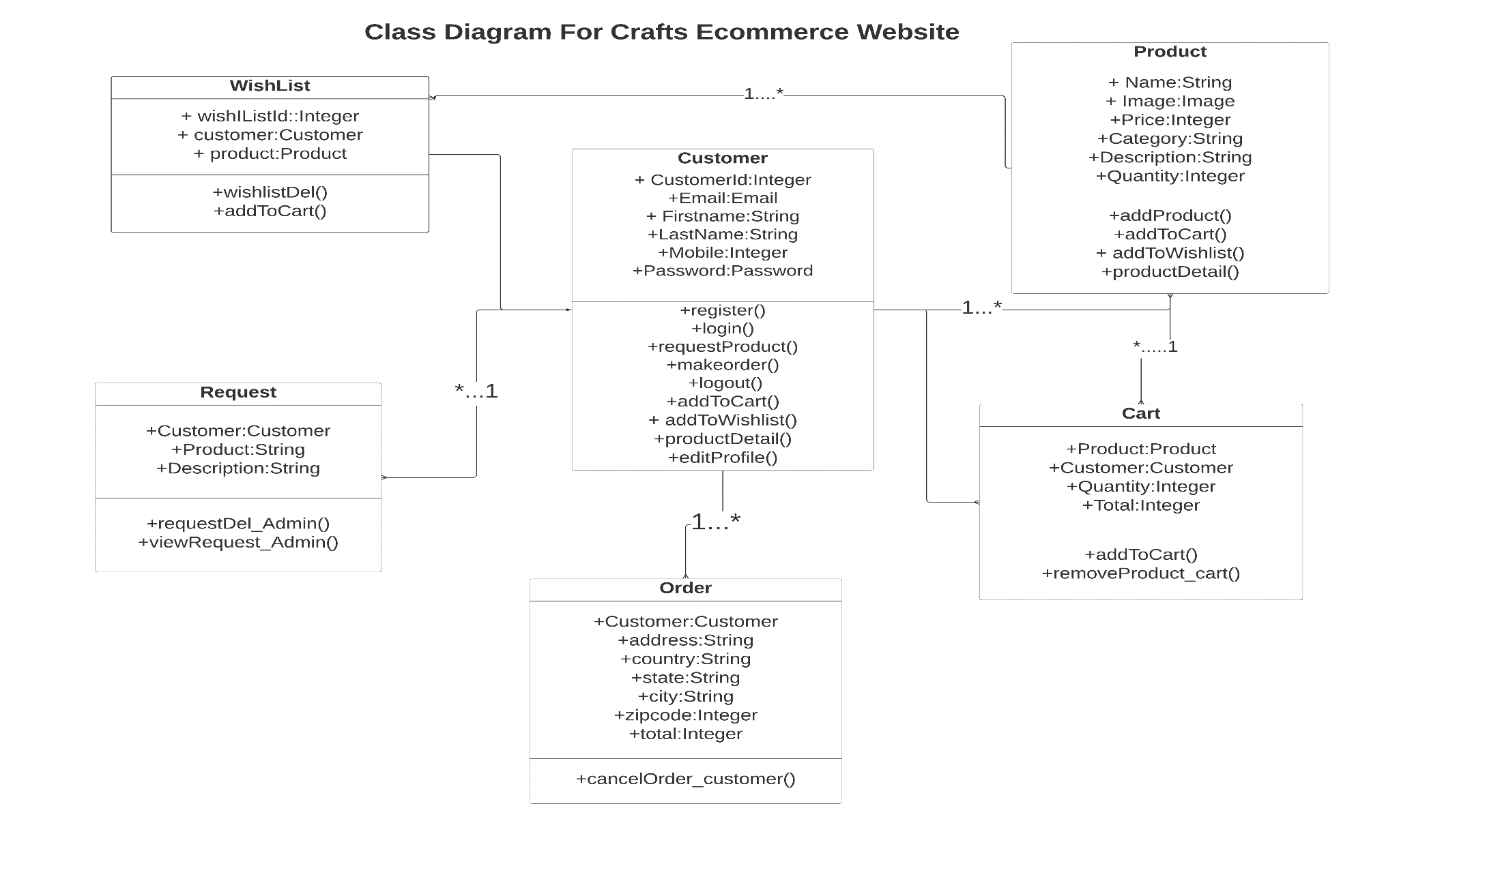
Class Diagram

Slide 10
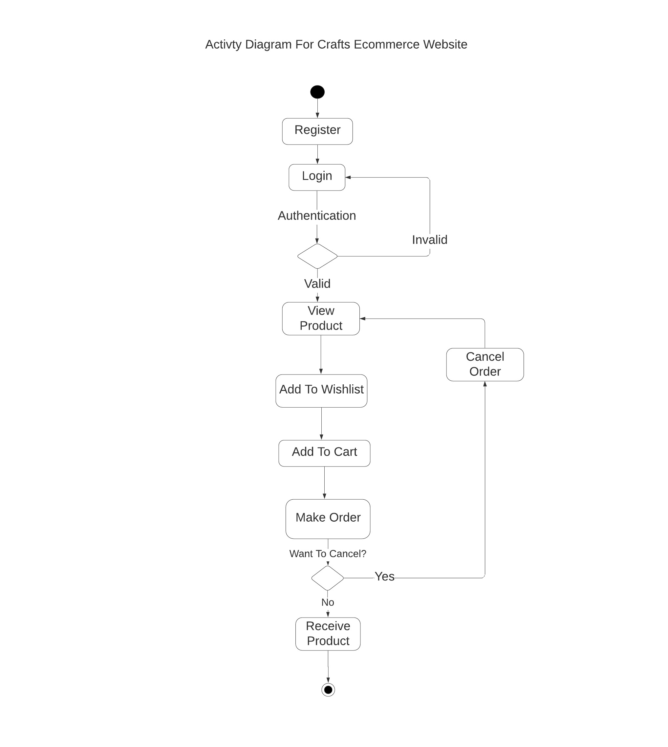
Activity Diagram

Slide 11
Database Design/Datasets
Customer
Product
Order
Wishlist
Request
Cart

Slide 12
Customer
Id | firstname | lastname | Mobile | email | Password
1 | Varshini | mosalikanti | 9666788909 | sita@gmail.com | *******
2 | Vasudha | koya | 8097654324 | cute@gmail.com | ********
3 | Divya | sankranthi | 7098564329 | sri@gmail.com | *********

Slide 13
Product
Id | ProductName | Image | Price | Category | Description | Quantity
1 | Elephant painting | Woodenelephant.jigi | 550 | Wooden toys | Design With wooden material | 10
2 | Kondapali toys | Kondapal toy. jghl | 300 | Konadapalli Toys | Beautiful and colourful toys | 20
3 | Krishna glass bottle painting | KrishnaGlass painting .lklk | 950 | Glass Paintings | Made with glass | 40

Slide 14
Request
RequestId | Customer Id | Product Id | ProductType | Description
1020 | 1 | 1234 | Toy | Teddy……….
1021 | 2 | 4568 | Art | Art…….
1029 | 3 | 6989 | Paint | Trees..…………

Slide 15
Wishlist
ID | Customer id | Product Id
5 | 1 | 1234
8 | 2 | 4568
9 | 3 | 6989

Slide 16
Order
OrderId | CustomerId | Address | Country | State | City | Zipcode | Total | CartId
1 | 123 | Sai Nagar | India | AP | Vizag | 534212 | 1234 | 6
2 | 456 | Gtown | India | MP | Bihar | 534234 | 7890 | 8

Slide 17
Cart
CartId | Customer id | Product Id | Quantity | Total
5 | 1 | 1234 | 5 | 5000
8 | 2 | 4568 | 7 | 1000
9 | 3 | 6989 | 10 | 10000

Slide 18
Modules
Register & Login
Add To Wishlist
Requesting For Product
Add To Cart
Cancel Order
Add Product(Admin)

Slide 19
Register & Login
Initially the customer register and then logins. If the customer did not have an account, he/she will register in order to create an account to use the website. The customer is asked to enter the details like Firstname , Lastname , phone number, email id, to create an account. All these details will be stored in the database.

Slide 20
Add To Wishlist
In this module, The customer can add his favorite product to wishlist and he can also remove products from wishlist.

Slide 21
Add To Cart
In this module, If the customer wants to buy the product then he will add the product to the cart. Total cost of the products will be displayed

Slide 22
Request Product
Customer can make a request to seller for the customized product through message option if that product is not available in the website
If he do not want to buy the product then he will cancel the order.
Cancel Order

Slide 23
Add Product(Admin)
He admin will upload product details like image, quantity, price and description of the Product into the website

Slide 24
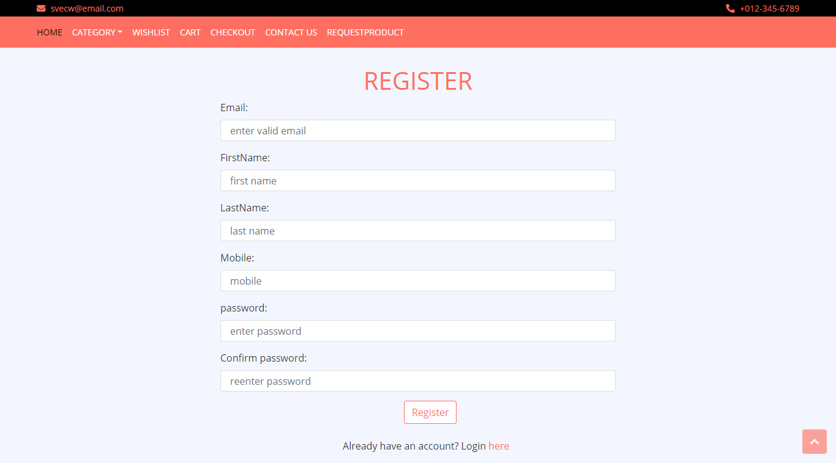

Slide 25
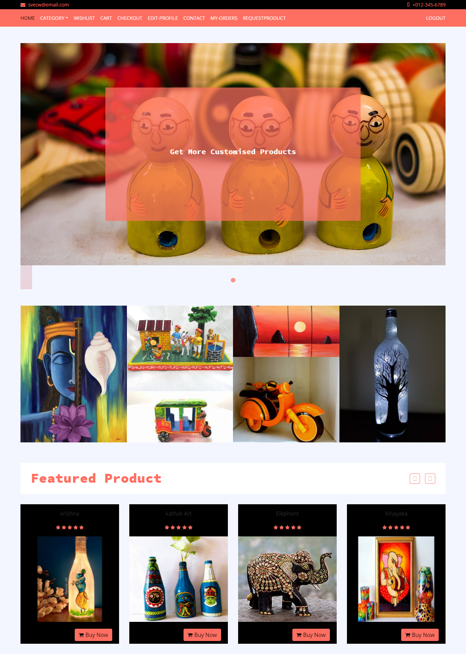

Slide 26
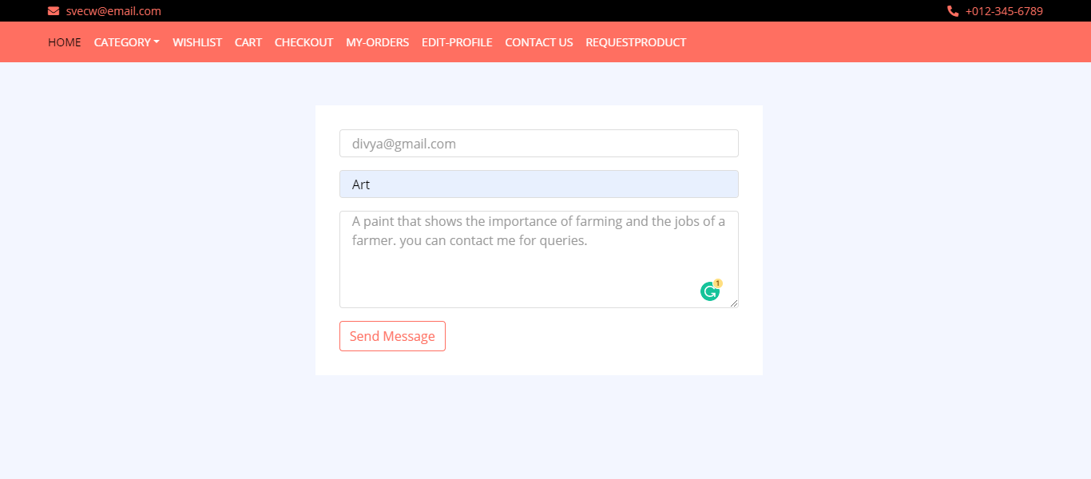

Slide 27
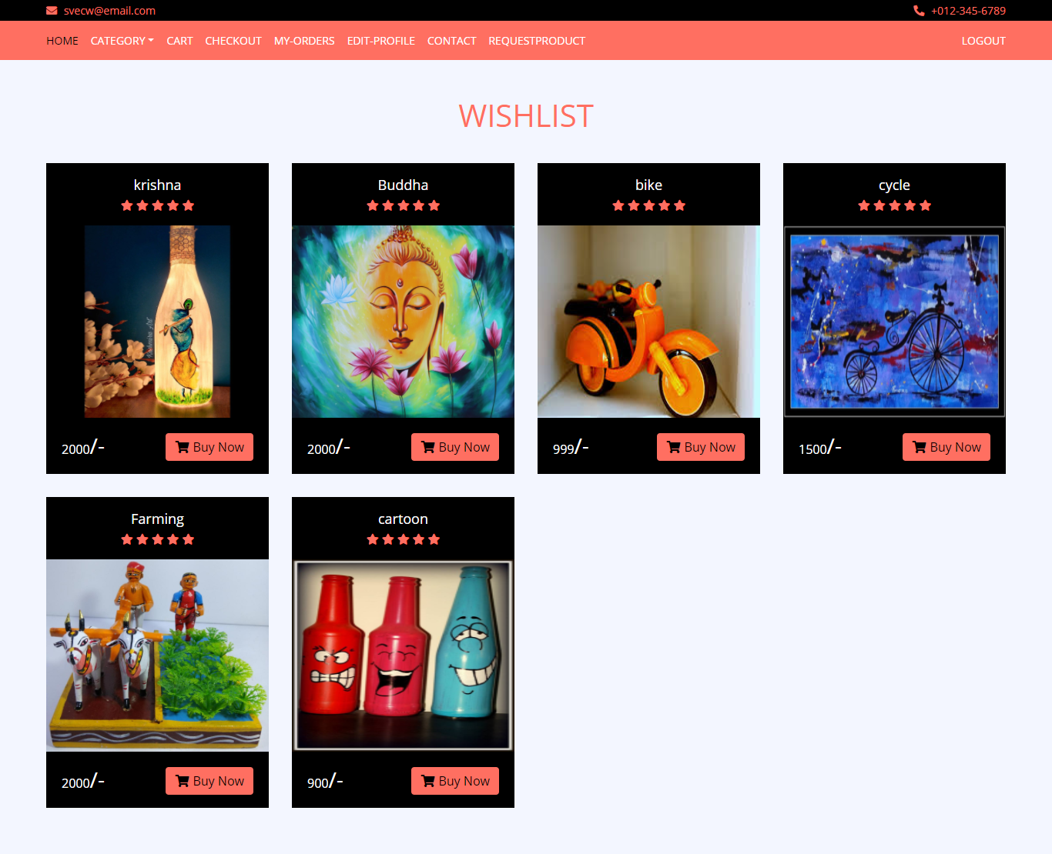
Screens

Slide 28
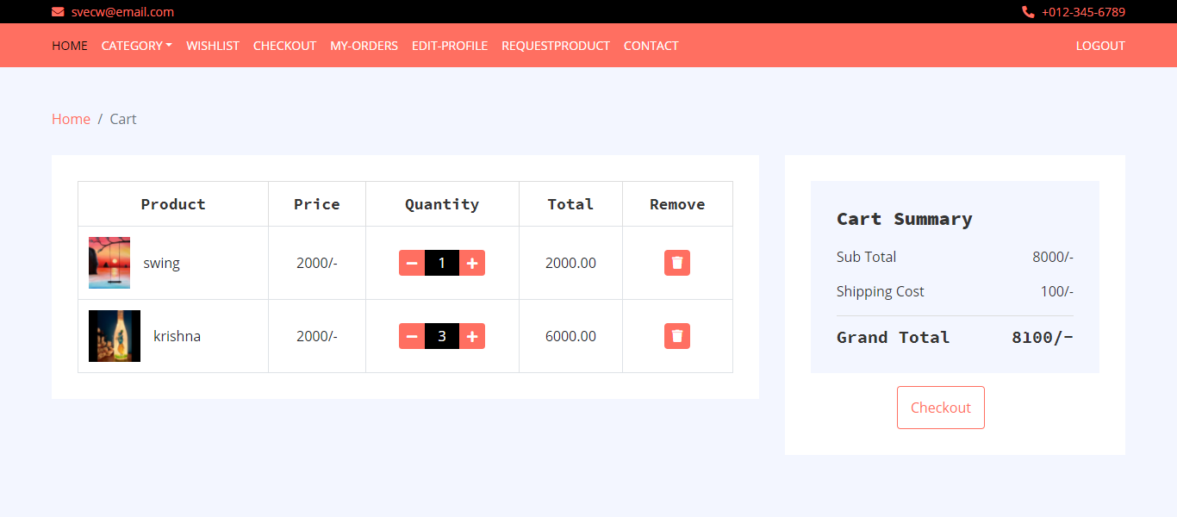

Slide 29
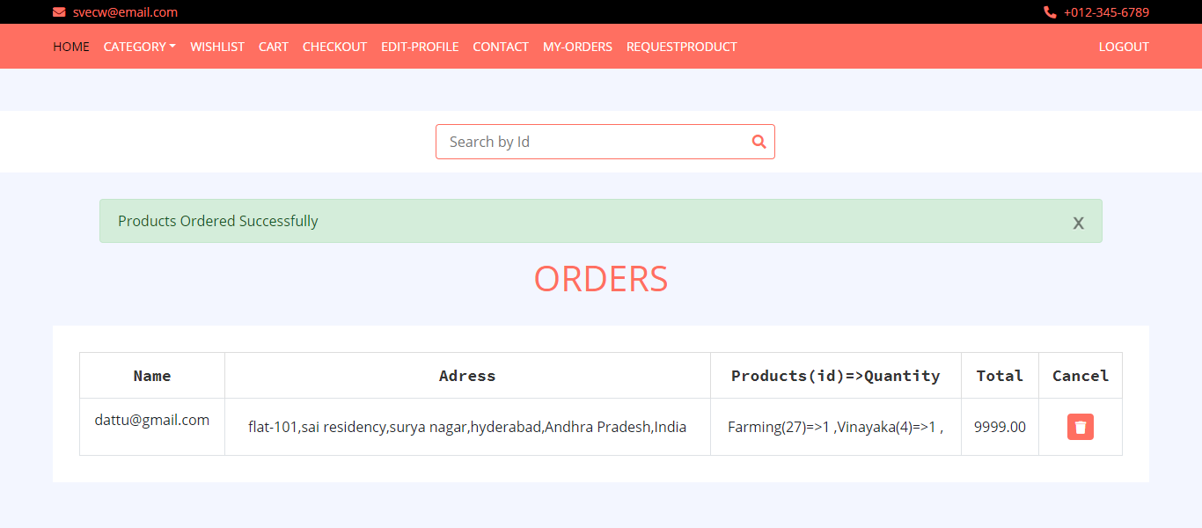

Slide 30
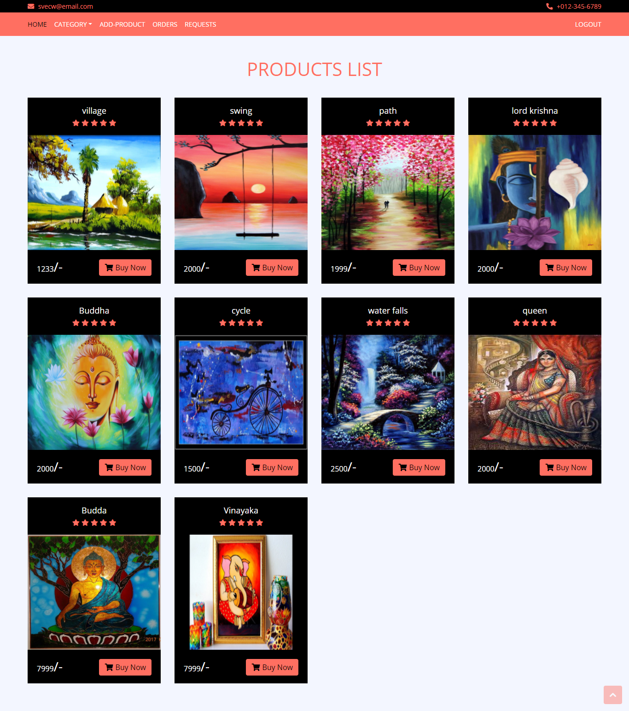

Slide 31
Conclusion
Our Website helps the Customers with more Customized Products with Message option which makes our Website more UserFriendly .
Any person can easily login to our website and find the crafts according to categories that he want and can order them or he can also add the products to his wishlist.

Slide 32


